Slide 1



PELTOR
Hygiene kit
2018-08-06

Slide 2
Why should I change the hygiene kit?
Avoid unsanitary fungus growth
Maintain product performance and attenuation
      Cushion material characteristics changes over time

Slide 3
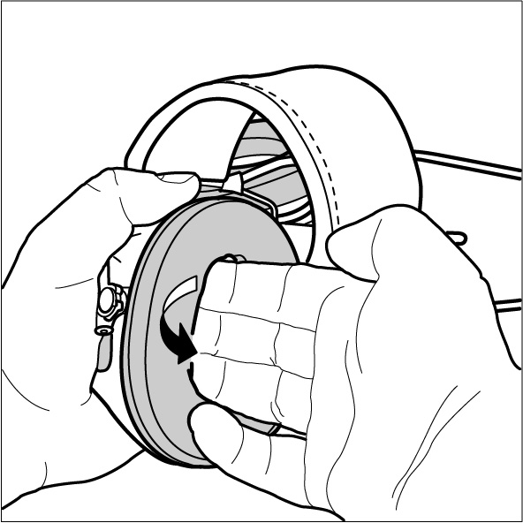
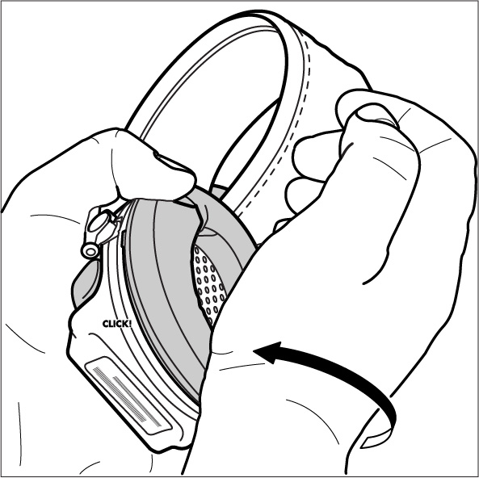
How do I change the hygiene kit?
Remove the exisiting hygiene kit from your headset. Make sure that your replacement kit correspond to the old one and attach it to the headset.

Slide 4
How often should I change my hygiene kit?
We recommend to change the hygiene kit once every six month.

Slide 5
Product | Article no. | Hygiene kit
Sporttac | MT16H210F-478* | HY21
ProTac lll Slim | MT13H220* | HY220
WorkTunes Pro FM-radio | HRXS220* | HY220
H505B for Welding | H505B-596-* | HY505
Optime 1 | H510* | HY51
Peltor KID | H510AK* | HY51
Bull´s Eye 1 | 515FB-516-* | HY51, HY51 GN
Bull´s Eye 2 | 520F-440-* | HY52
H31 | H31* | HY52
Optime 2 | H520* | HY52
Push To Listen MT155H530 | MT155H530* | HY53 PTL
Optime 3 | H540* | HY54
Bull´s Eye 3 | 540-441-GN | HY54 GN
WS SportTac, WS SportTac Light | MT16H21FWS5*-584GN | HY68 SV
WS Workstyle | MT16H21FWS5*-580SV | HY68 SV

Slide 6
Product | Article no. | Hygiene kit
LiteCom | MT53H7*4*00* | HY79
LiteCom Plus | MT7H7*4 | HY79
Tactical XP | MT1H7-*2-* | HY79
WS Headset XP | MT53H7*WS5 | HY79
WS LiteCom | MT53H7*4410WS5 | HY79
WS ProTac XP | MT15H7*WS5 | HY79
Alert | M2RX7*- 0* | HY79, HY81
FM Radio | HTRXS7A*-0* | HY81
Radio XP | HRXP7*-01 * | HY81
WS Alert XP | MRX21A2WS6* | HY81
DAB+ FM radio | HRXD7A* | HY82
WS Alert XPI | MRX21AWS6* | HY82
WS LiteCom PRO lll | MT73H7*4D10N* | HY83

Slide 7
Product | Article no. | Hygiene kit
X1 | X1* | HYX1
X2 | X2* | HYX2
X3 | X3* | HYX3
X4 | X4* | HYX4
X5 | X5* | HYX5

